Slide 1
Unit 7
Polish and Publish Application

Slide 2
Publishing Android Application
Android application publishing is a process that makes your Android applications available to users.
Once you developed and fully tested your Android Application, you can start selling or distributing free using Google Play (A famous Android marketplace).
You can also release your applications by sending them directly to users or by letting users download them from your own website.

Slide 3
Regression Testing
basic quality expectations
Application Rating
Everyone
Targeted Regions
countries
Territories
Low maturity
Medium maturity
High maturity
Application Size
App Size
SDK and Screen Compatibility
Android platform versions
device screen sizes
Application Pricing
free
Paid
Promotional Content
quality graphic assets
Build and Upload release-ready APK
upload to the Developer Console and distribute to users
Finalize Application Detail
Promote
Engage with user
phone and tablets

Slide 4
Export Android Application Process
Java
Java Compiler
.class
DX Compiler
.dex file
AAPT kit
.APK

Slide 5
Dx tools(Dalvik executable tools ): It going to convert .class file to .dex file. it has useful for memory optimization and reduce the boot-up speed time
AAPT(Android assistance packaging tool):it has useful to convert .Dex file to.Apk
APK(Android packaging kit): The final stage of deployment process is called as .apk.
Build → Generate Signed APK
Create new keystore → Enter your key store path, key store password, key alias and key password to protect your application and click on Next button once again
Finish → generate your Android Application as APK formate File

Slide 6
Mobile App Monetization
Mobile app monetization is the process of generating revenue to support your app. There are a number of app monetization models to choose from — many of which can be combined to diversify your revenue streams. The best fit for your app will depend on your app’s vertical and target audience.

Slide 7
In-App Advertising
In-App Purchases
Subscription Model
Paid Apps (One-Time Purchase)
Freemium Model
Affiliate Marketing
Sponsorships and Partnerships

Slide 8
Versioning
Versioning is a critical component of your application upgrade and maintenance strategy. Versioning is important because:
Users need to have specific information about the application version that is installed on their devices and the upgrade versions available for installation.
Other applications — including other applications that you publish as a suite — need to query the system for your application's version, to determine compatibility and identify dependencies.
Services through which you will publish your application(s) may also need to query your application for its version, so that they can display the version to users. A publishing service may also need to check the application version to determine compatibility and establish upgrade/downgrade relationships.

Slide 9
To define the version information for your application, you set attributes in the application's manifest file. Two attributes are available, and you should always define values for both of them:
android:versionCode — An integer value that represents the version of the application code, relative to other versions.
android:versionName — A string value that represents the release version of the application code, as it should be shown to users.

Slide 10
<?xml version="1.0" encoding="utf-8"?>
<manifest xmlns:android="http://schemas.android.com/apk/res/android"
package="com.example.package.name"
android:versionCode="2"
android:versionName="1.1">
<application android:icon="@drawable/icon" android:label="@string/app_name">
...
</application>
</manifest>

Slide 11
Semantic Versioning (Major.Minor.Patch):
Major: Significant updates or breaking changes (e.g., 2.0.0).
Minor: New features without breaking existing ones (e.g., 1.1.0).
Patch: Bug fixes or small improvements (e.g., 1.0.1).

Slide 12
Application's System API Requirements
To specify API Level requirements, add a <uses-sdk> element in the application's manifest, with one or more of these attributes:
Attribute | Description
android:minSdkVersion | Minimum API level required to install and run the app.
android:targetSdkVersion | Recommended API level the app is designed for.
android:maxSdkVersion (Optional) | Highest API level the app supports. (Rarely used, as it may prevent updates on new Android versions.)

Slide 13
App Signing in Android
App signing is the process of digitally signing an Android APK or AAB file to verify its authenticity and integrity. It is mandatory for publishing apps on Google Play.
Android apps are signed with a private key. To ensure that app updates are trustworthy, every private key has an associated public certificate that devices and services use to verify that the app update is from the same source. Devices only accept updates when its signature matches the installed app's signature.
App signing allows developers to identify the author of the app and to update their app without creating complicated interfaces and permissions. Every app that is run on the Android platform must be signed by the developer.

Slide 14
Android supports three app signing schemes:
v1 scheme: based on JAR signing
Signs individual JAR (Java Archive) files inside the APK.Uses
ZIP format, meaning modifications (like ZIP alignment) invalidate the signature.
v2 scheme: APK Signature Scheme v2, which was introduced in Android 7.0.
Signs the entire APK instead of individual JAR files.
Uses a cryptographic hash to verify the full APK.
v3 scheme: APK Signature Scheme v3, which was introduced in Android 9.
Supports key rotation (allows signing key to be changed in future updates).
Provides stronger security over APK integrity.

Slide 15
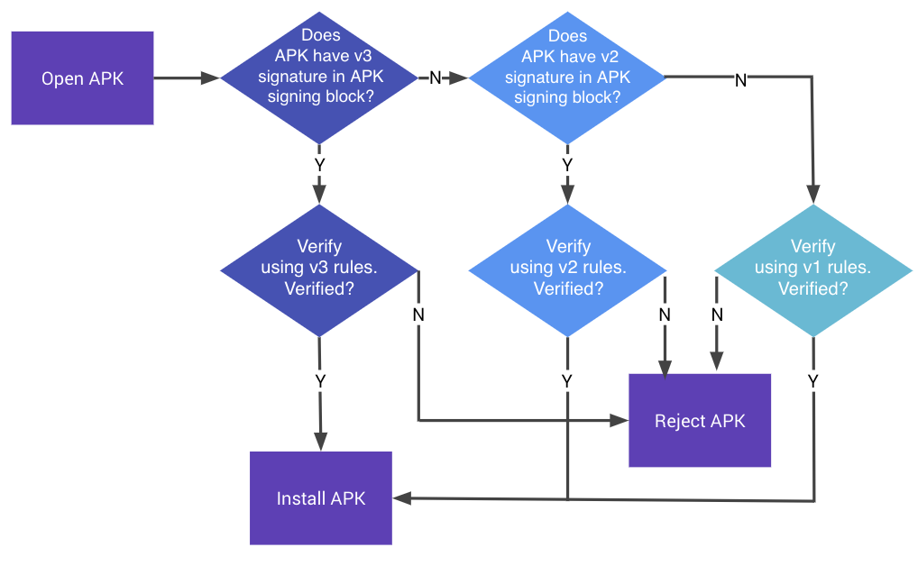

Slide 16
Packaging and Beta Test of Mobile Application
Packaging refers to the process of bundling an app's code, resources, and dependencies into a distributable format (APK/AAB for Android) for testing or release.
APK (Android Package)
Android Studio (Build → Build Bundle(s) / APK(s) → Build APK(s)).
Command line (gradlew assembleRelease).
AAB (Android App Bundle)
Android Studio (Build → Build Bundle(s) / APK(s) → Build Bundle).
Command line (gradlew bundleRelease).

Slide 17
Mobile Application Testing
Mobile Application Testing refers to the process of evaluating the functionality, usability, and performance of mobile apps across various devices and platforms to ensure they meet quality standards and deliver a seamless user experience.
It encompasses testing aspects such as functionality, compatibility, security, and user interface to identify and rectify issues before the app's release.

Slide 18
Approaches to Test the Mobile Application
Test Mob App
Manual Testing
Automation Testing
Beta Testing
Testing of Devices

Slide 19
Manual Testing
Exploratory testing: It involves testers experimenting with the program to find bugs without using pre-defined test cases.
Ad Hoc Testing: To find issues rapidly, testers do impromptu tests without a hard and fast methodology.
Usability testing: To ensure the software program lives as much as consumer expectancies, testers determine the user interface, navigation, and standard consumer experience.

Slide 20
Automation Testing
Functional Testing: To test the application's functionality across a range of scenarios and user interactions, automation scripts are written.
Regression Testing: To ensure that new updates do not add any new issues or destroy contemporary capability, automatic tests are performed again after each code exchange.
Testing for Compatibility: Automation scripts are used to check if an application is compatible with various hardware, operating systems, and screen sizes.

Slide 21
Beta Testing
Before the app's official release, a small set of actual users are given access to a limited version of it through beta testing. Beta tester's feedback is useful in locating flaws, usability problems, and potential improvement areas.

Slide 22
Types of Beta Testing
Traditional Beta testing: Product is distributed to the target market and related data is gathered in all aspects. This data can be used for Product improvement.
Public Beta Testing: Product is released publicly to the world through online channels and data can be collected from anyone. Based on feedback, product improvements can be done. For example, Microsoft conducted the largest of all Beta Tests for its operating system Windows 8 before officially releasing it.
Technical Beta Testing: Product is released to a group of employees of an organization and collects feedback/data from the employees of the organization.
Focused Beta Testing: a Software product is released to the market for collecting feedback on specific features of the program. For example, important functionality of the software.
Post-release Beta Testing: a Software product is released to the market and data is collected to make improvements for the future release of the product.

Slide 23
Tools used for Beta Testing
Test Fairy
Center Code
TryMyUI
User Testing
TestRail
Usersnap
Zephyr
TestFlight

Slide 24
Testing of Devices
Real Device Testing: To guarantee realistic performance and behavior, the app is tested on real devices, taking into account elements like hardware capabilities and device-specific features.
Emulator/Simulator Testing: The application is evaluated using simulated devices that replicate real-world functionality. For testing Android apps, emulators are utilized, whilst simulators are utilized for testing iOS apps.

